Slide 1

ISE 218: Fundamentals of Information Technology Unit 7: System Software
Spring 2025
Instructor: Abid Malik
co-Instructor: Xinrui Yu

Slide 2
Objective
Become familiar with the functions provided by operating systems, programming tools, database software, and transaction managers.
Understand the role played by each software component in maintaining the integrity of a computer system and its data.

Slide 3
Introduction
The biggest and fastest computer in the world is of no use if it cannot efficiently provide beneficial services to its users.
Users see the computer through their application programs. These programs are ultimately executed by computer hardware.
System software – in the form of operating systems and middleware – is the glue that holds everything together.
Middleware provides services above the OS but below user application software (e.g., game engines, database connectivity packages)
Notes:
Chpter 1 -

Slide 4
A Quick History of Operating Systems
The evolution of OSes has paralleled the evolution of computer hardware.
As hardware became more powerful, operating systems allowed people to more easily manage the power of the machine.
In the days when main memory was measured in kilobytes, and tape drives were the only form of magnetic storage, operating systems were simple resident monitor programs.
The resident monitor could only load, execute, and terminate programs.
Early OSes – in the form of resident monitors – used batch processing
Jobs were fed by a human operator into the computer on punched cards and run in one or more large batches of tasks
The resident monitor then ran the programs in sequence without further human intervention

Slide 5
A Quick History of Operating Systems
As more sophistication crept into resident monitors – starting/stopping jobs, handling I/O, switching between jobs – monitors evolved into more complex operating systems more like OSes of today
In the 1960s, hardware had become powerful enough to accommodate multiprogramming, the concurrent execution of more than one task.
Multiprogramming is achieved by allocating each process a given portion of CPU time (a time slice).
Interactive multiprogramming systems were called timesharing systems.
Multiple, concurrent users connect to the computer via terminals
When a process is taken from the CPU and replaced by another, we say that a context switch has occurred.

Slide 6
A Quick History of Operating Systems
Today, multiprocessor systems have become commonplace.
They present an array of challenges to the operating system designer, including the manner in which the processors will be synchronized, and how to keep their activities from interfering with each other.
Tightly coupled multiprocessor systems share a common memory and the same set of I/O devices.
Symmetric multiprocessor (SMP) systems are tightly coupled and load balanced. All processors work on a common task together.
Loosely coupled multiprocessor systems have physically separate memory.
These are often called distributed systems.
Another type of distributed system is a networked system, which consists of a collection of interconnected, collaborating workstations.

Slide 7
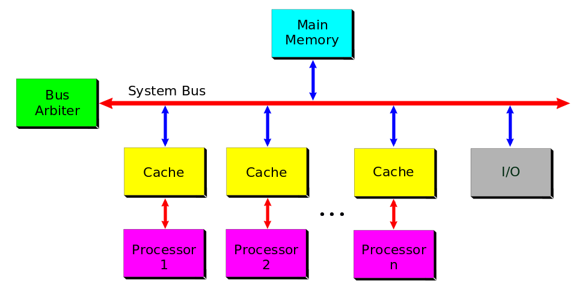
Symmetric Multiprocessor Architecture

Slide 8
A Quick History of Operating Systems
In a distributed system, the user is not necessarily aware that her/his work is being performed by a set of networked computers.
In a networked system, the user is aware of the different machines.
Real-time operating systems control computers that respond to their environment.
Hard real-time systems have tight timing constraints, whereas soft real-time systems do not.
What kinds of real-world systems must have real-time response or someone could die or some other disaster might occur?

Slide 9
A Quick History of Operating Systems
Personal computer operating systems are designed for ease of use rather than high performance.
The idea that revolutionized small computer operating systems was the BIOS (basic input-output system) chip that permitted a single operating system to function on different types of small systems.
The BIOS handles the details involved in interfacing with a variety of peripheral device designs and protocols.
Operating systems having graphical user interfaces were first brought to market in the 1980s.
At one time, these systems were considered appropriate only for desktop publishing and games. Today they are seen as technology enablers for users with little formal computer education.

Slide 10
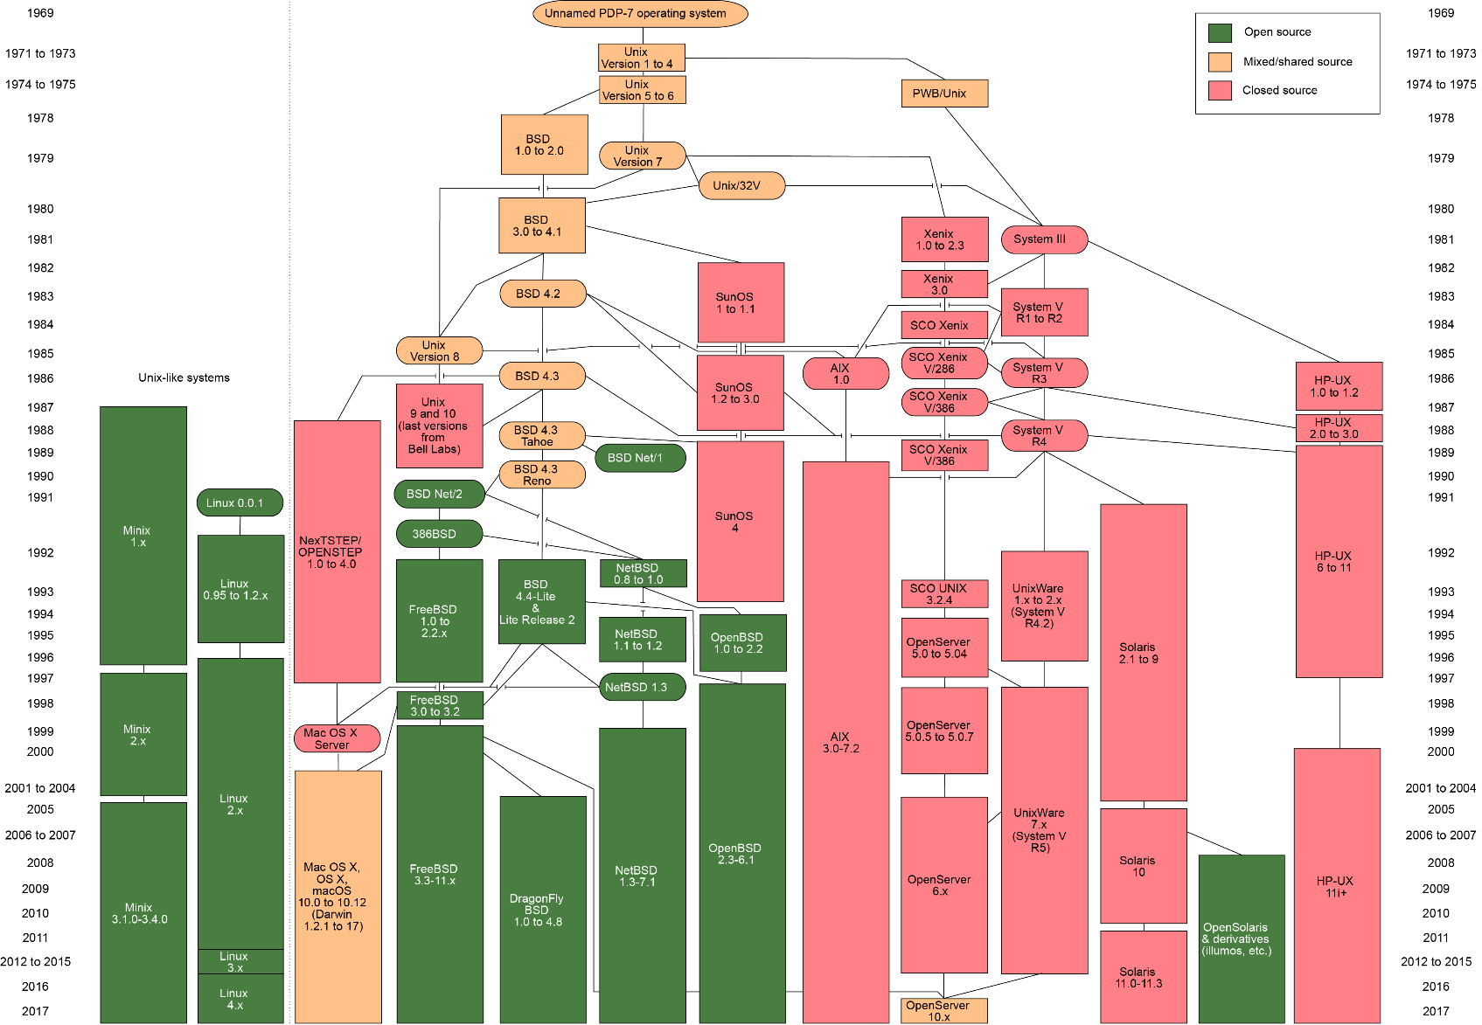
A Quick History of Operating Systems
Unix is an OS developed by researchers at AT&T Bell Labs in the 1960s that has spawned hundreds of variants since that time
Linux has brought Unix from the world of servers to ordinary desktop systems.

Slide 11
Operating System Design
Two operating system components are crucial: the kernel and the system programs.
As the core of the operating system, the kernel performs scheduling, synchronization, memory management, interrupt handling and also provides security and protection.
Microkernel systems provide minimal functionality, with most services carried out by external programs.
Monolithic systems provide most of their services within a single operating system program.

Slide 12

Operating System Design
Microkernel systems provide better security, easier maintenance, and portability at the expense of execution speed. (Examples: MINIX, Mach, QNX.)
SMP computers are ideal platforms for microkernel operating systems because they consist of small services that can run independently
Monolithic systems give faster execution speed, but are difficult to port from one architecture to another. (Examples: Linux, MacOS, and DOS.)
Windows has a hybrid kernel with aspects of both microkernels and monolithic kernels
The Windows OS consists of many modules that communicate with the main part of the kernel. This is basically how a microkernel operates.
However, these modules share memory with the rest of the kernel, which is how a monolithic kernel is structured.

Slide 13
Operating System Services
What are some of the responsibilities or tasks of an operating system that you are familiar with?
In other words, what are some basic tasks a computer can perform that are not necessarily associated with a single program or group of programs?

Slide 14
Operating System Services
Process management lies at the heart of operating system services.
The operating system creates processes, schedules their access to resources, deletes processes, and deallocates resources that were allocated during process execution.
The operating system monitors the activities of each process to avoid synchronization problems that can occur when processes use shared resources.
If processes need to communicate with one another, the operating system provides the services.

Slide 15
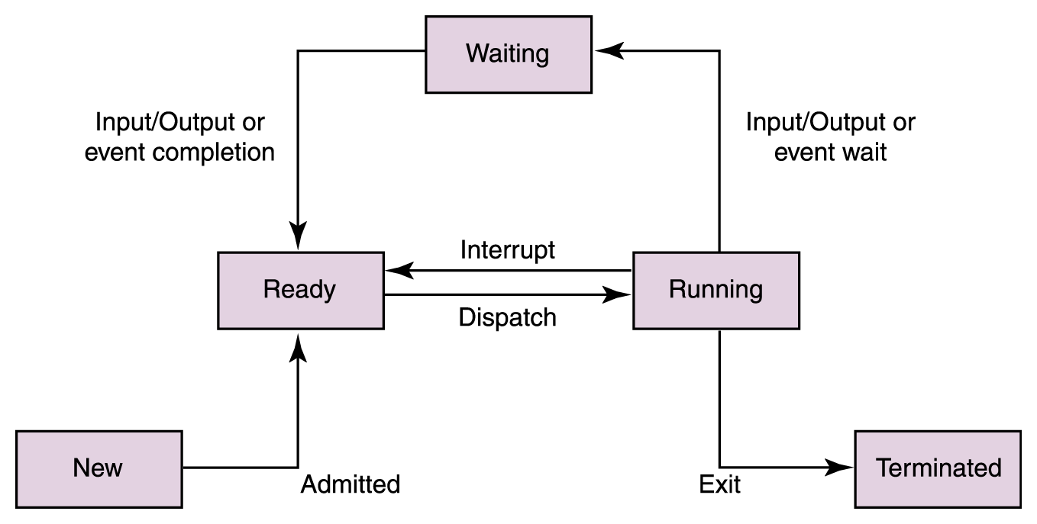




Process States

Slide 16

Process Scheduling
The operating system schedules process execution.
First, the operating system determines which process shall be eventually granted access to the CPU. This is long-term scheduling.
After a number of processes have been admitted, the operating system determines which one will have access to the CPU at any particular moment. This is short-term scheduling.
A context switch occurs when a process is taken from the CPU and replaced by another process.
Information relating to the state of the process is preserved during a context switch, such as the contents of registers and the page tables
The state of the other process is restored and resumed
This kind of bookkeeping is time-consuming and burns many CPU cycles

Slide 17
Process Scheduling
Short-term scheduling can be preemptive or non-preemptive.
In preemptive scheduling, each process is allocated a time slice. When the time slice expires, a context switch occurs.
In non-preemptive scheduling, a process has use of the CPU until either it terminates, or must wait for resources that are temporarily unavailable.
A context switch can also occur when a higher-priority process needs the CPU.

Slide 18
Process Scheduling
Four approaches to CPU scheduling are:
First-come, first-served: jobs are serviced in arrival sequence and run to completion if they have all of the resources they need.
Shortest job first: the smallest jobs get scheduled first. (The trouble is in knowing which jobs are shortest!)
Round robin scheduling: each job is allotted a certain amount of CPU time (called a time quantum). A context switch occurs when the time expires.
Priority scheduling: preempts a job with a lower priority when a higher-priority job needs the CPU.
Some process scheduling algorithms can cause starvation. This occurs when a process never gets a chance to run because other processes are continually being given preference. Which of the scheduling approaches could cause this?

Slide 19
First-come, First-served Scheduling
Processes P1, P2 and P3 “arrive” to the CPU in that order. The execution time requirements are:
Process Burst Time
P1 24 ms
P2 3 ms
P3 3 ms
First consider the Gantt chart above, which visualizes the process execution
What is the average wait time for the processes?
Waiting times: P1 = 0 ms, P2 = 24 ms, P3 = 27 ms
Average waiting time: (0 + 24 + 27)/3 = 17 ms
P1
P2
P3
0
24
27
30 ms

Slide 20
Shortest Job First Scheduling
Processes P1, P2, P3 and P4 arrive to the CPU in that order at the times given below. The execution time requirements are:
Process Arrival Time Burst Time
P1 0 ms 7 ms
P2 2 ms 4 ms
P3 4 ms 1 ms
P4 5 ms 4 ms
What is the average wait time for the processes?
Waiting times: P1 = 0 ms, P2 = (8 – 2) = 6 ms, P3 = (7 – 4) = 3 ms, P4 = (12 – 5) = 7 ms
Average waiting time: (0 + 6 + 3 + 7)/4 = 4 ms
P1
P3
P2
P4
0
7
8
12
16 ms

Slide 21
Round Robin Scheduling
Processes P1, P2, P3 and P4 arrive to the CPU in that order, all at around time 0 ms. Round robin scheduling is being used with a time quantum of 20 ms.
Process Burst Time Time Remaining
P1 53 ms 53 – 20 → 33 – 20 → 13 → 0
P2 17 ms 17 → 0
P3 68 ms 68 – 20 → 48 – 20 → 28 – 20 → 8
P4 24 ms 24 – 20 → 4 → 0
The Gantt chart below illustrates when each process will execute on the CPU
P₁
P₂
P₃
P₄
P₁
P₃
P₄
P₁
P₃
P₃
0
20
37
57
77
97
117
121
134
154
162 ms

Slide 22
Round Robin Scheduling
P₁
P₂
P₃
P₄
P₁
P₃
P₄
P₁
P₃
P₃
0
20
37
57
77
97
117
121
134
154
162 ms
Given the above Gantt chart, what is the average wait time for the processes?
Wait time for P1 = (77 – 20) + (121 – 97) = 81 ms
Wait time for P2 = 20 ms
Wait time for P3 = 37 + (97 – 57) + (134 – 117) = 94 ms
Wait time for P4 = 57 + (117 – 77) = 97 ms
Average wait time = (81 + 20 + 94 + 97)/4 = 73 ms

Slide 23
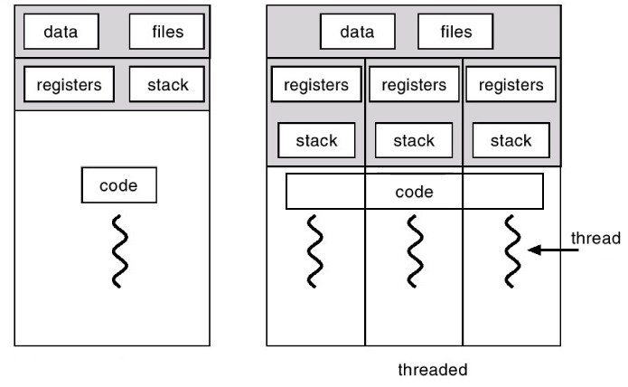
Process Scheduling
Modern OSes also support multitasking (allowing multiple processes to run concurrently) and multithreading (allowing a single process to be subdivided into different threads of control)
A thread can be scheduled, just like a process
The threads of a process share the resources of the process, such as its memory, which makes it faster to context switch between threads than processes

Slide 24
Resource Management
The OS manages the CPU via the process scheduler
It must also manage the main memory (e.g., virtual memory, paging, segmentation) and I/O devices
The OS must also protect the kernel from interference by user processes
For example, what if multiple processes want to transmit data over the network connection simultaneously? The OS has to mediate these requests and service them in some order.
The OS also manages the filesystem, the methods and structures used by the OS to organize and manage files stored on disk

Slide 25
Protected Environments
In their role as resource managers and protectors, many operating systems provide protected environments that isolate processes, or groups of processes from each other.
Three common approaches to establishing protected environments are virtual machines, subsystems, and partitions.
These environments simplify system management and control, and can provide emulated machines to enable execution of programs that the system would otherwise be unable to run.

Slide 26
Virtual Machines
Virtual machines are a protected environment that presents an image of itself – or the image of a totally different architecture – to the processes that run within the environment.
A virtual machine is exactly that: an imaginary computer.
The underlying real machine is under the control of the kernel. The kernel receives and manages all resource requests that emit from processes running in the virtual environment.
VMs give one way of running untrusted software in a safe environment
The next slide provides an illustration.

Slide 27
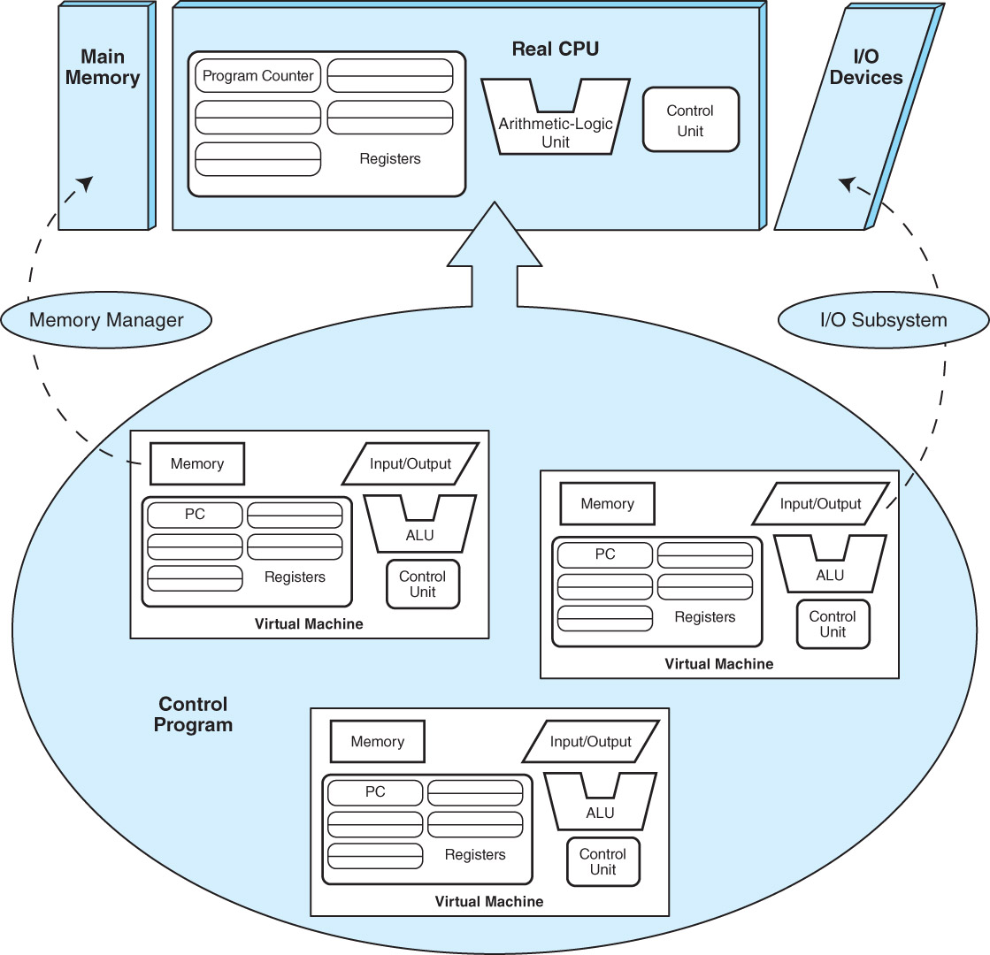
Virtual Machines
VMs on a personal computer allow the user to install and run multiple operating systems without removing or impacting the current operating system
Since VMs are simulated machines, they run much more slowly than if they were installed directly on real, physical hardware

Slide 28
Subsystems and Partitions
Subsystems are another type of protected environment.
They provide logically distinct environments that can be individually controlled and managed. They can be started and stopped independently of each other.
Subsystems can have special purposes, such as controlling I/O or virtual machines. Others partition large application systems to make them more manageable.
In many cases, resources must be made visible to the subsystem before they can be accessed by the processes running within it.
The next slide provides an illustration.

Slide 29
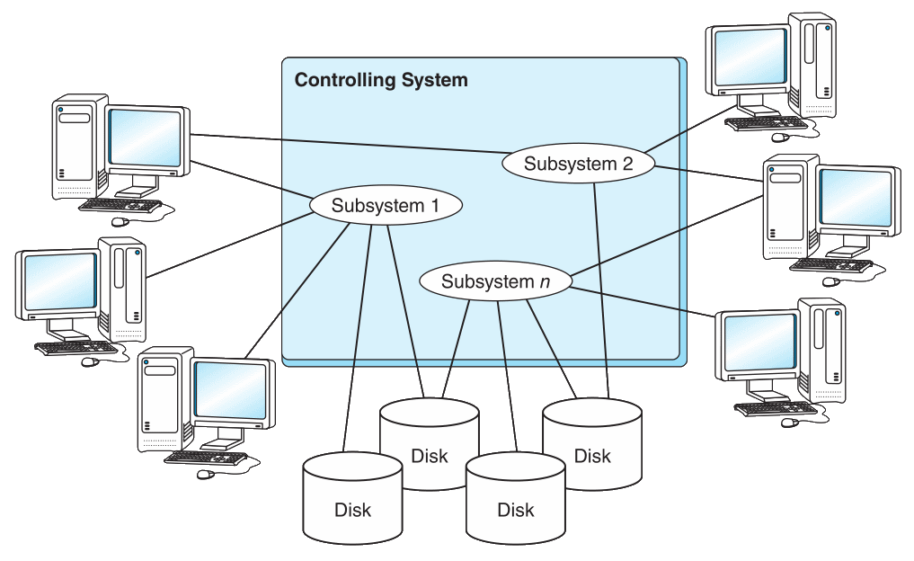
Subsystems Example

Slide 30
Partitions
In very large computers, subsystems do not go far enough to establish a protected environment.
Logical partitions (LPARs) provide much higher barriers: Processes running within a logical partition have no access to processes running in another partition unless a connection between them is explicitly established.
LPARs are an enabling technology for the recent trend of consolidating hundreds of small servers within the confines of a single large system.
The next slide provides an illustration.

Slide 31
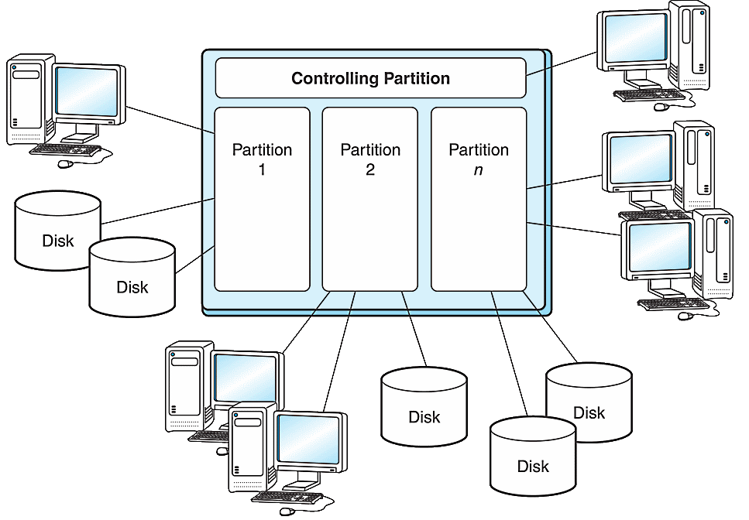
Logical Partitions Example

Slide 32
Logical Partitions
LPARs are good for creating “sandbox” environments
On one powerful server (or set of machines) we might have a copy of the released version of some software produced by a company
This version would run in its own partition
On the same server we might have a “development” version that programmers are using to work on the next version of the software
The two copies of the software can run and exist on the same computer(s) without interference from each other

Slide 33
Server Consolidation
In the 1990s large server farms provided computing power and miscellaneous services (file hosting, printer management, etc.) for a company
Server farms can contain hundreds of machines, which are expensive and difficult to maintain
A modern trend is server consolidation, which means to replace farms with a single, powerful computer that support virtual environments and logical partitions
These servers can support hundreds or thousands of virtual machines (e.g., Linux VMs), each of which can be running some enterprise system, such as an e-commerce system
IBM’s current zSeries mainframes have up to 32 CPUs with up to 256 GB RAM per CPU

Slide 34
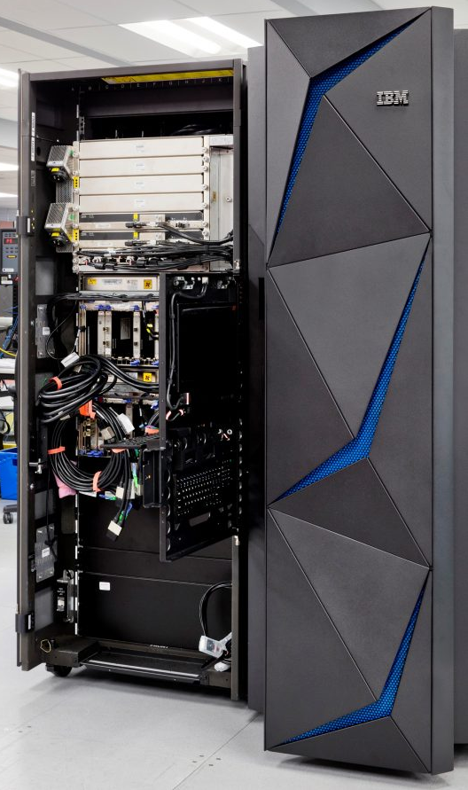
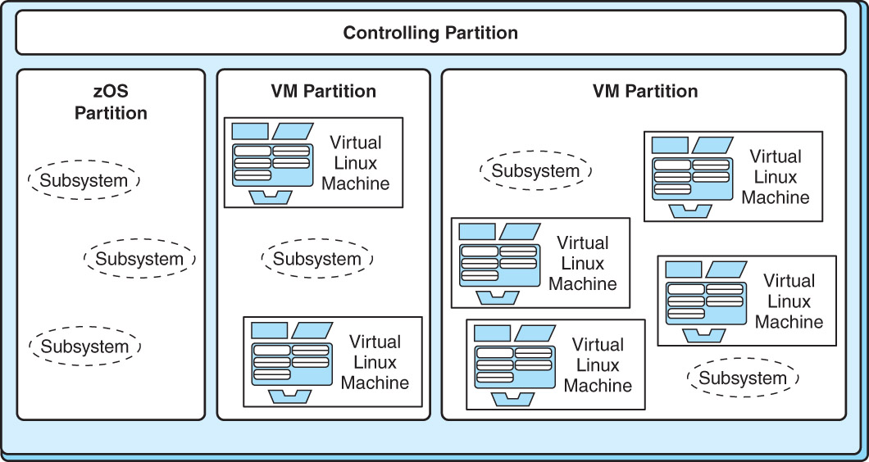
Server Consolidation

Slide 35
Programming Tools
Programming tools carry out the mechanics of software creation within the confines of the operating system and hardware environment.
Assemblers are the simplest of all programming tools. They translate mnemonic instructions to machine code.
Assembly language is considered a “second generation” programming language (2GL).
High-level programming languages, such as C, C++, Pascal, and COBOL, are “third generation” languages (3GLs).
Each language generation presents problem solving tools that are closer to how people think and farther away from how the machine implements the solution.

Slide 36
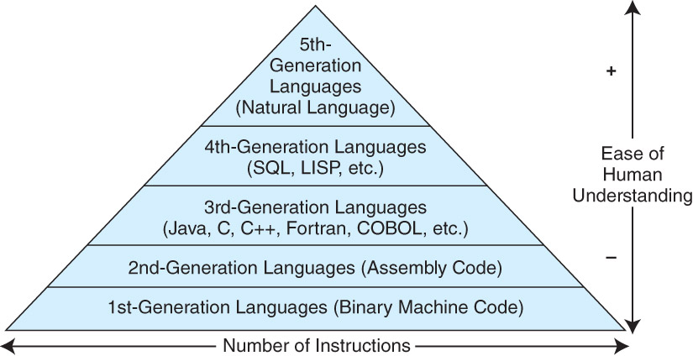
Programming Tools

Slide 37
Programming Tools
Compilers bridge the semantic gap between the higher level language and the machine’s binary instructions.
A compiler takes the source code for a program as input and then outputs machine code for the target platform
This is a multi-step process that first analyzes the code for its structure and, assuming the code is syntactically correct, generates the machine code
Modern compilers also attempt to optimize the code so that the compiled program runs as fast as possible
Popular compiled languages include C, C++, Java

Slide 38
Programming Tools
Interpreters produce executable code from source code in real time, one line at a time.
Consequently, this not only makes interpreted languages slower than compiled languages but it also affords less opportunity for error checking.
Interpreted languages are, however, very useful for teaching programming concepts, because feedback is nearly instantaneous, and performance is rarely a concern.
Also, in software development, interpreted languages are very useful when the underlying code needs to be changed frequently
Popular interpreted languages include JavaScript (for the web), Python, Ruby, Java
Wait…I thought Java was compiled?

Slide 39
Java: All Most of the Above
The Java programming language exemplifies many of the concepts that we have discussed so far in this Unit
Java programs execute within a virtual machine, the Java Virtual Machine (JVM).
This allows the language to run on any platform for which a virtual machine environment has been written. (“Write once, run anywhere.”)
Java is both a compiled and an interpreted language. The output of the compilation process is an assembly-like intermediate code (bytecode) that is interpreted by the JVM.
The JVM is an operating system in miniature. It runs programs, manages program resources, and deallocates resources when the programs terminate.

Slide 40
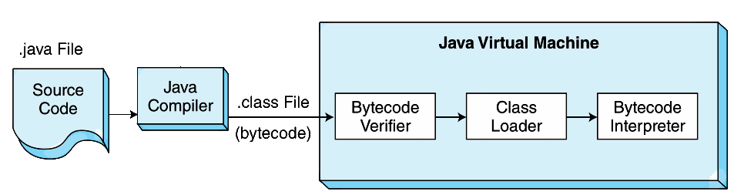
Java: All Most of the Above
Because the JVM performs many tasks at run time, its performance cannot match the performance of a traditional compiled language.

Slide 41
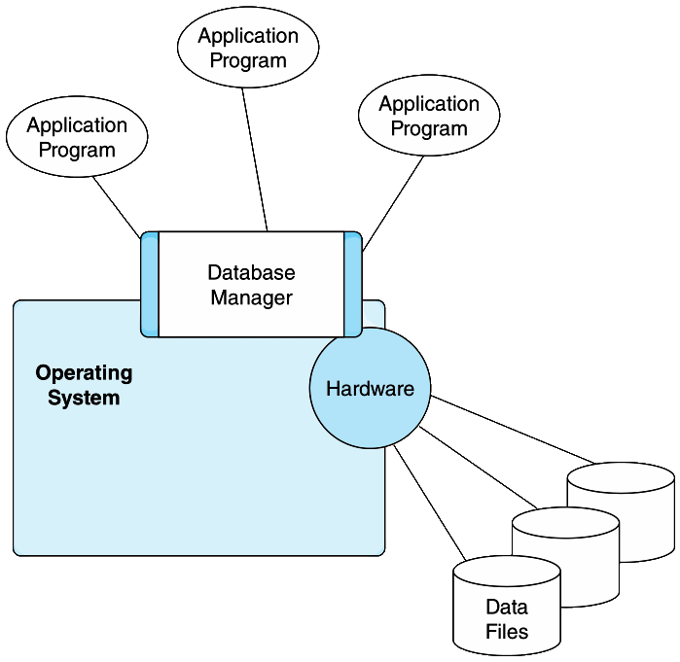
Database Software
Database systems contain the most valuable assets of an enterprise.
They are the foundation upon which application systems are built.
The database manager (also called the database engine) provides an interface for application programs to interact with the data stored in the data files

Slide 42
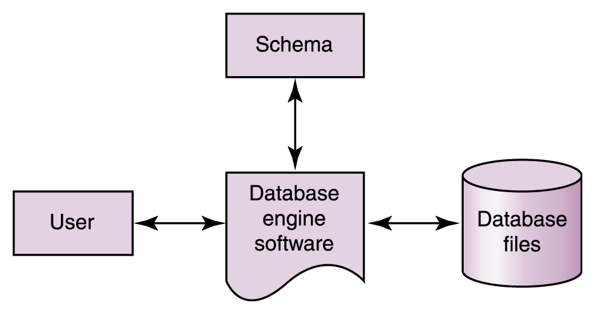
Database Software
The database engine will support the common CRUD operations on data: create, read, update, delete
Database systems provide a single definition, the database schema, for the data elements that are accessed by application programs.
A physical schema is the computer’s view of the database that includes locations of physical files and indexes.
A logical schema is the application program’s view of the database that defines field sizes and data types.
The logical scheme defines the structure of the data as perceived by the user and used by the software

Slide 43
The Relational Model
Relational DBMS: a DBMS in which the data items and the relationships among them are organized into tables
Table: a collection of records
Record: a collection of related fields that make up a single database entry and that usually represents some object or entity in the real world
Field: a single value in a database record that represents some attribute of an object
Each field has a data type, like date/time, integer, text, and so on

Slide 44
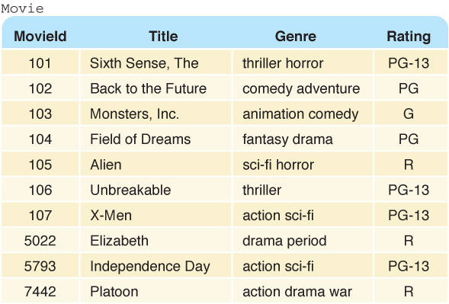
An Example Database Table
How do we uniquely identify a record in the Movie table below?

Slide 45
The Relational Model
Within the logical schema, certain data fields are designated as record keys that provide efficient access to records in the database.
The key is one or more fields of a database record that uniquely identifies it among all other records in the table
We can express the schema for this part of the database as follows:
Movie (MovieId:key, Title, Genre, Rating)
Why not simply use a movie’s title as the key?

Slide 46
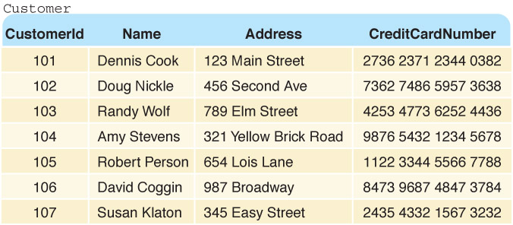
Another Example Database Table
The Customer table:
How might we record that a particular customer has rented a particular movie?

Slide 47
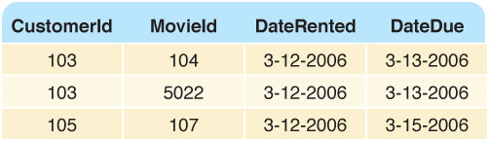
Relationships
How do we relate movies to customers?
By a table, of course!
The Rents table below tells us which customer is renting which movie(s)

Slide 48
Database Software: Transaction Management
Most database systems also include transaction management components to assure that the database is always in a consistent state.
Transaction management provides the following “ACID” properties:
Atomicity: All related updates occur, or no updates occur.
Consistency: All updates conform to defined data constraints.
Isolation: No transaction can interfere with another transaction.
Durability: Successful updates are written to durable media as soon as possible.

Slide 49
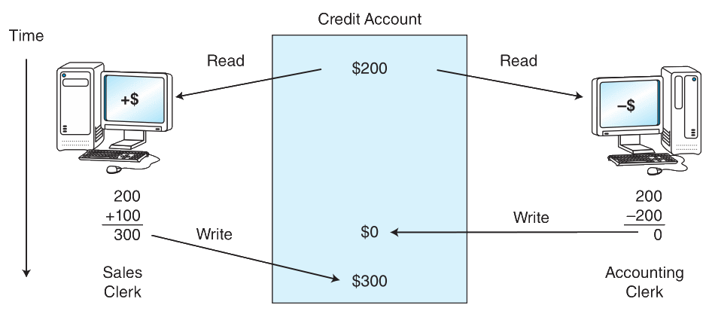
Database Software: Transaction Management
Without the ACID properties, race conditions can occur:

Slide 50
Database Software: Transaction Management
In the previous example, the final state of the database depends not on the correctness of the updates, but on which transaction happens to finish last
If only read operations are taking place on a database, then no race condition can exist
The trouble lies with write operations that are not properly synchronized for concurrently executed transactions
The transactions need to be executed sequentially and atomically
A race condition is present when the final state of the database depends on which of several concurrently executing transactions completes first (wins the “race”), leading to data inconsistencies

Slide 51
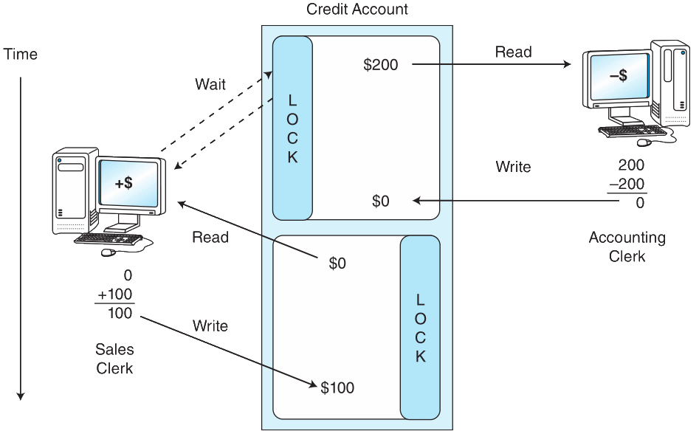
Database Software: Transaction Management
Record locking mechanisms assure isolated, atomic database updates and help avoid race conditions

Slide 52
Database Software: Transaction Management
In enterprise systems, the DBMS will maintain log files of the transactions performed on the database
The transaction is recorded to the log file before being executed on the database
This is called write-ahead logging
Logs are helpful for error recovery if the database becomes corrupted before being backed up
The log file can be used to restore the proper state of the database

Slide 53
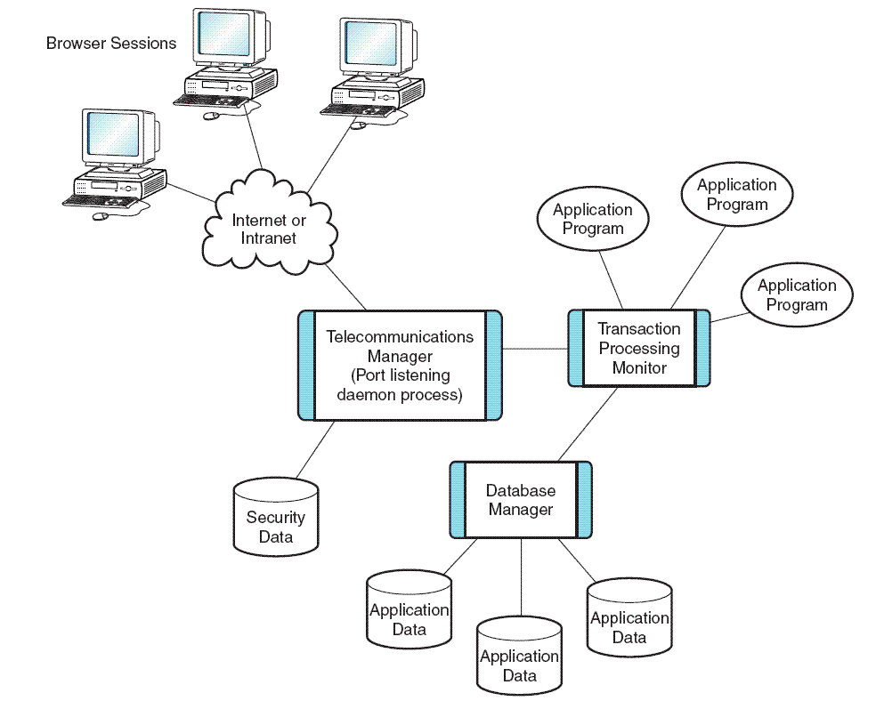
Database Software: Transaction Management
One way to improve database performance is to have it do less work by moving some of its functions to specialized software.
Transaction management is one component that is often partitioned from the core database system.
Transaction managers are especially important when the transactions involve more than one physical database, or the application system spans more than one class of computer, as in a multi-tiered architecture.

